Slide 1

AVIATION Profitability
Presented by CodeX
Xto10X Hackathon
Developed By CodeX :- Girish Kumar , Komal Yadav , Rohith Kumar

Slide 2
01
Problem Statement

Slide 3
Problem Statement
VENUS
Objective:
To develop a high-performance Machine Learning model that predicts Profit (USD) for airline operations, optimizing financial and operational decision-making.
Key Features Used:
Operational Metrics: Flight Delays, Aircraft Utilization, Turnaround Time, Fleet Availability, Maintenance Downtime, Fuel Efficiency.
Financial Metrics: Revenue, Operating Costs, Net Profit Margin, Ancillary Revenue, Debt-to-Equity Ratio.
Performance Challenges: Seasonal fluctuations, operational inefficiencies, cost variations.

Slide 4
02
Dataset Overview

Slide 5
Dataset Overview
VENUS
Basic Information:
Dataset Name: Aviation KPIs Dataset
Source: Hackathon
Shape: 2 lakh rows and 18 columns
Key Columns:
Input Features: Flight Delays, Aircraft Utilization, Turnaround Time, Load Factor, Revenue, Operating Costs, etc.
Target Variable: Profit (USD)

Slide 6
03
EDA Insights

Slide 7
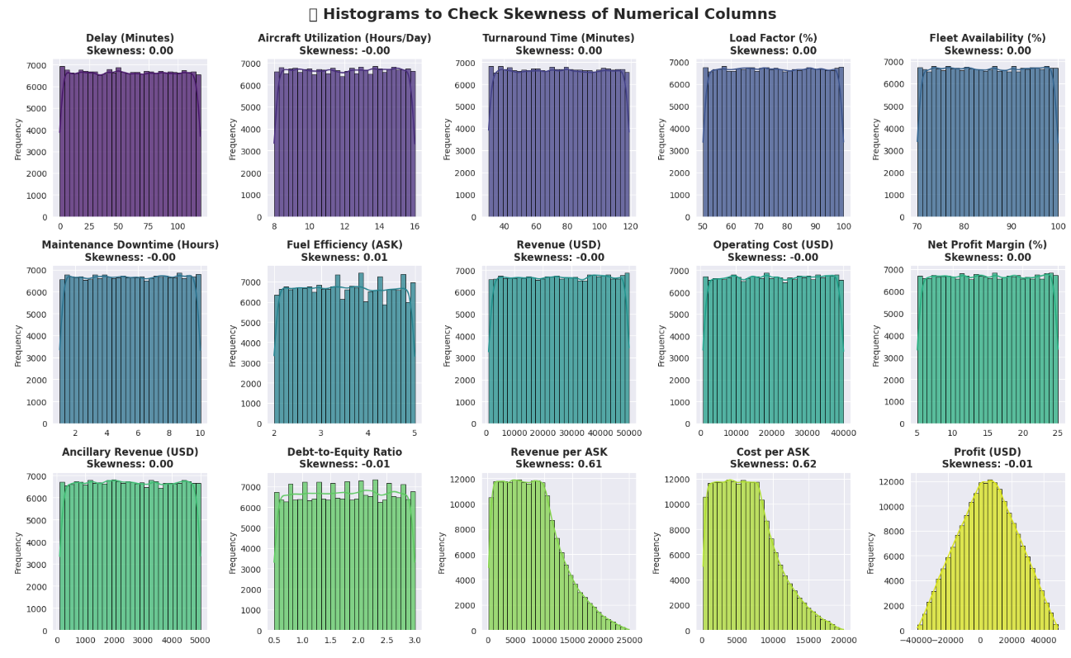
EDA
VENUS

Slide 8
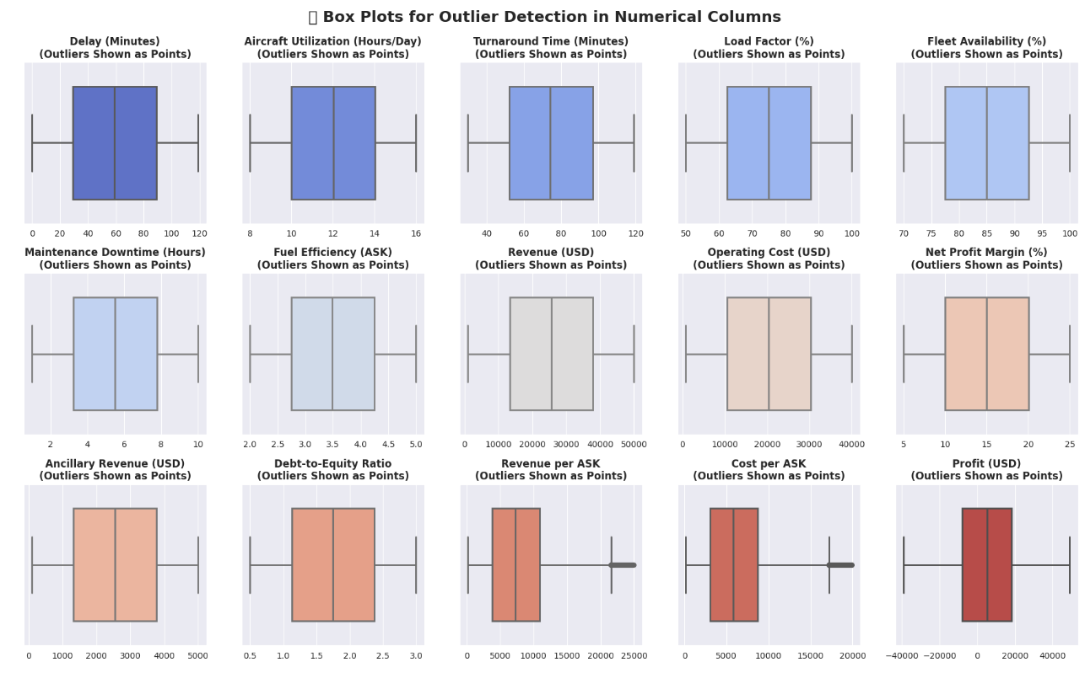
EDA
VENUS

Slide 9
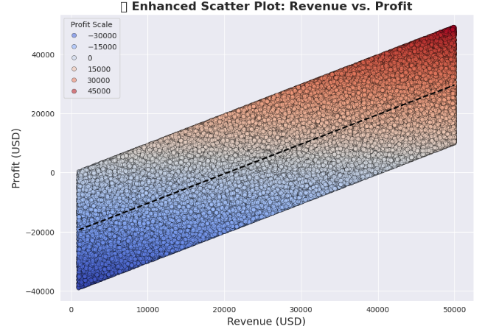
EDA
VENUS

Slide 10
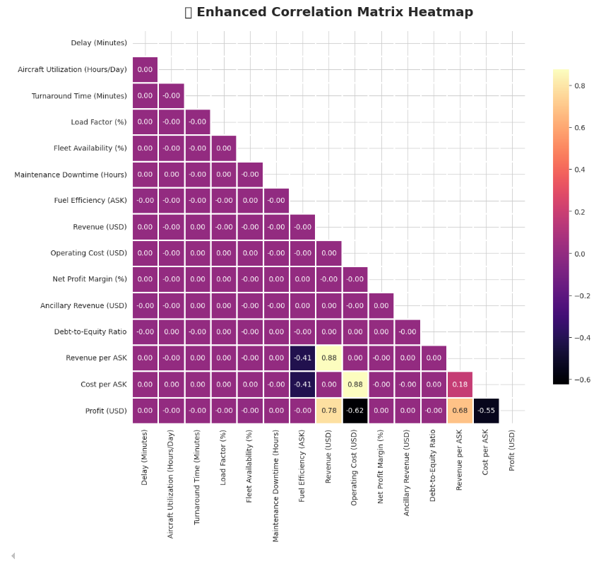
EDA
VENUS

Slide 11
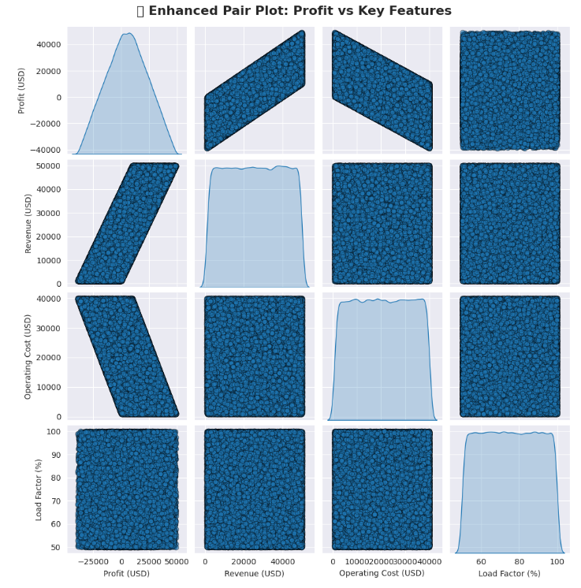
EDA
VENUS

Slide 12
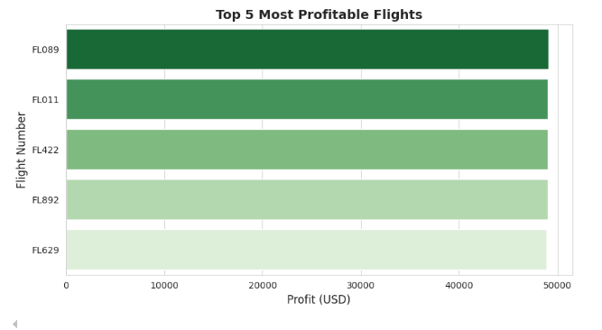
EDA
VENUS

Slide 13
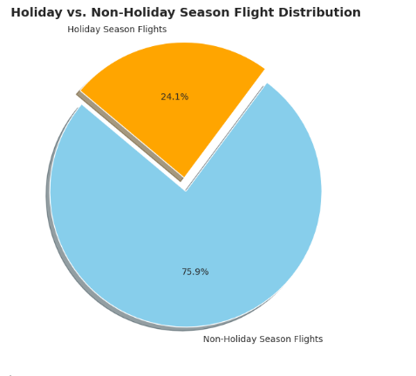
EDA
VENUS

Slide 14
04
Model Selection

Slide 15
Model Selection
VENUS
>> Explaining through Script

Slide 16
05
Model Performance

Slide 17
Model Performance Summary
VENUS
The Stacked Model (LightGBM + XGBoost + Random Forest) significantly outperformed individual models.
74% improvement in MAE (from 94.27 → 25.33) and RMSE reduction from 120.18 → 34.89.
Near-perfect R² Score (0.999996) ensures high predictive accuracy.
Model | MAE (Lower Better) | RMSE (Lower Better) | R² Score (Higher Better)
LightGBM (Best Before Tuning) | 94.27 | 120.18 | 0.999956
Fine-Tuned LightGBM | 103.62 | 133.15 | 0.999946
✅ Stacked Model (LGBM + RF + XGB) | 25.33 ✅ | 34.89 ✅ | 0.999996 ✅

Slide 18
06
Key Findings

Slide 19
Key Findings
VENUS
Top Factors Impacting Profitability:
Revenue (USD) → Strongest positive impact on profit.
Operating Cost (USD) → High costs reduce profit margins.
Load Factor (%) → Higher occupancy leads to better profitability.
Flight Delays (Minutes) → Delays increase operational costs, reducing profitability.
Maintenance Downtime (Hours) → More downtime = lower fleet utilization, impacting revenue.

Slide 20
07
Recommendations

Slide 21
Recommendations
VENUS
Increase Flight Utilization Efficiency: Minimize turnaround times and reduce unnecessary downtime.
Optimize Pricing Strategies: Maximize revenue per ASK while keeping costs under control.
Invest in Predictive Maintenance: Reduce unexpected aircraft maintenance downtime.
Improve Fuel Efficiency: Optimizing routes and fleet composition to lower operating costs.

Slide 22
08
Conclusion
key points

Slide 23
Conclusion
VENUS
The Stacked Model provides highly accurate and explainable profitability predictions. Implementing the insights from this project can lead to higher operational efficiency and increased airline profits
Actionable Recommendations
Improve Flight Utilization & Efficiency
Reduce turnaround time to minimize unnecessary delays.
Invest in predictive maintenance to prevent unexpected downtime.
Cost Optimization Strategies
Enhance fuel efficiency by optimizing routes and aircraft selection.
Introduce dynamic pricing models based on demand trends.

Slide 24
Conclusion
VENUS
Revenue Growth Opportunities
Expand ancillary revenue streams (seat upgrades, baggage fees, in-flight sales).
Implement targeted marketing to maximize load factor on underperforming routes.

Slide 25
Thank you

